Slide 1
Pre-Calc & Trig
Day 49

Slide 2
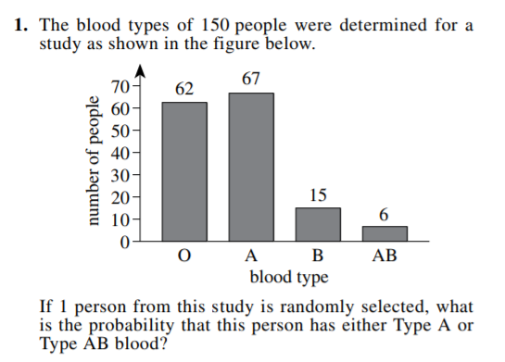
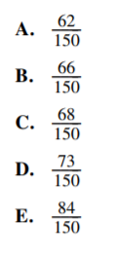
Bell Work

Slide 3
Go Over Old Quiz and Quick Review for Solving Quiz

Slide 4
Unit 6 Quiz 2
Solving Trig Functions
Level 4 Hint: Remember how to factor quadratics
Half sheet of paper

Slide 5
Trig Identities Test
Level 2
-- Simplify using trig functions
-- Evaluate sum and difference (no variable)
-- Solve: algebra (2 step equations) & unit circle
Level 3
-- Evaluate sum & difference (with a variable)
-- Verify using trig identities
-- Solve: algebra (two step or factoring) & unit circle
-- Double angle using SOH-CAH-TOA from triangle
Level 4
-- Verify -- Solve

Slide 6
Ways to Study
MAKE YOUR 1 PIECE CHEET SHEET
Read through page 416 – 417
Work problems associated with the sections outlined above… heavy emphasis on 5.1, 5.2 and 5.3
Additional, limited amount, problems with 5.4 and 5.5
Chapter Test (page 421) has some additional problems

